Slide 1
Python Session 7.2 – Lambda, MAP, Reduce

Slide 2
Lambda – Nameless functions
Python’s lambda creates anonymous functions (i.e. functions that are not bound to a name)
Note: only one expression in the lambda body; Its value is always returned
The lambda expression must fit on one line
lambda args: expression
>>> f = lambda x: x + 1
>>> f(100)
101
>>> f = lambda x,y : 2 * x + y
>>> f(3, 4)

Slide 3
Lambda vs function
>>> def f (x): return x**2
>>> print f(8)
64
>>> g = lambda x: x**2
>>> print g(8)
64

Slide 4
Higher-Order Functions
Higher-order functions are functions that take other functions as arguments
They can be use to implement algorithmic skeletons
Generic algorithmic techniques
Three predefined higher-order functions are specially useful for working with list
map
reduce
filter

Slide 5
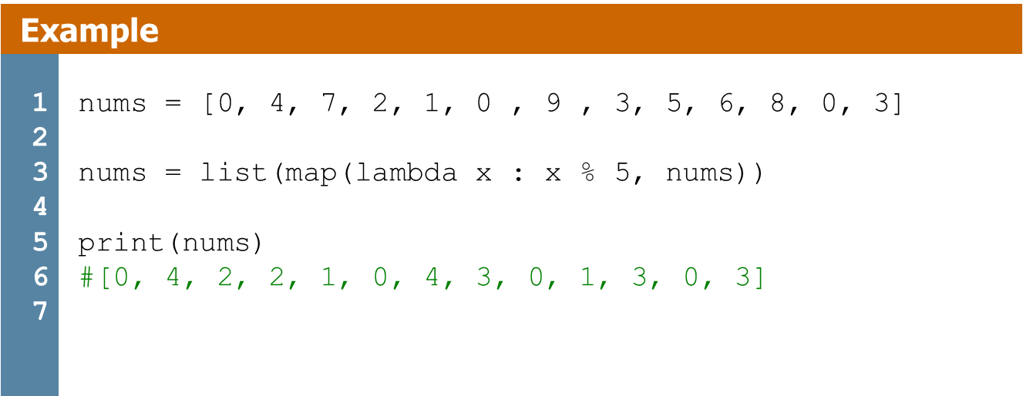
Map
"map(function, sequence)" calls function(item) for each of the sequence's items and returns a list of the return values.
More than one sequence may be passed
the function must then have as many arguments as there are sequences
It is called with the corresponding item from each sequence (or None if some sequence is shorter than another). If None is passed for the function, a function returning its argument(s) is substituted.
For example, to compute some cubes:
>>> def cube(x): return x*x*x
>>> map(cube, range(1, 11))
[1, 8, 27, 64, 125, 216, 343, 512, 729, 1000]

Slide 6
Map
Combining these two special cases, we see that "map(None, list1, list2)" is a convenient way of turning a pair of lists into a list of pairs.
For example
>>> seq = range(8)
>>> def square(x): return x*x
...
>>> map(None, seq, map(square, seq))
[(0, 0), (1, 1), (2, 4), (3, 9), (4, 16), (5, 25), (6, 36), (7, 49)]

Slide 7
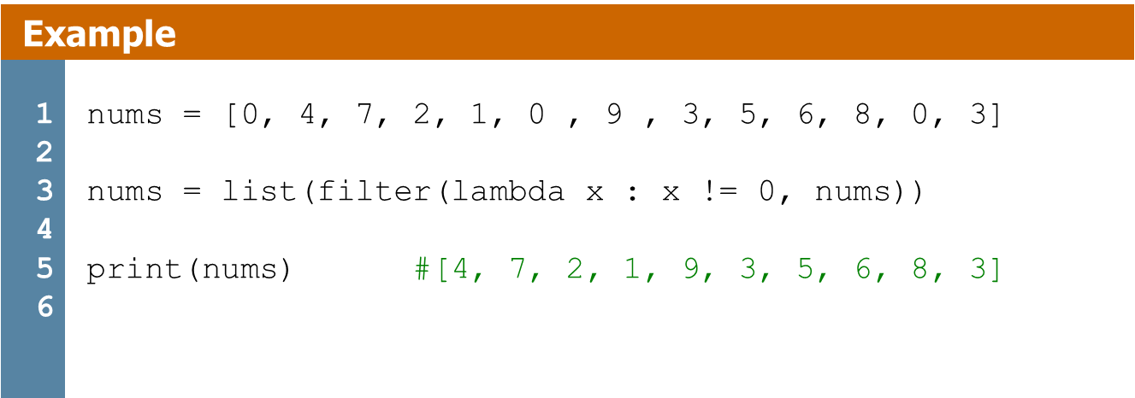
Filter
filter(function, iterable)
Extracts the elements of a list that satisfy a boolean function
filter(function, sequence)" returns a sequence (of the same type, if possible) consisting of those items from the sequence for which function(item) is true.
For example, to compute some primes:
>>> def f(x): return x % 2 != 0 and x % 3 != 0
>>> filter(f, range(2, 25))
[5, 7, 11, 13, 17, 19, 23]

Slide 8
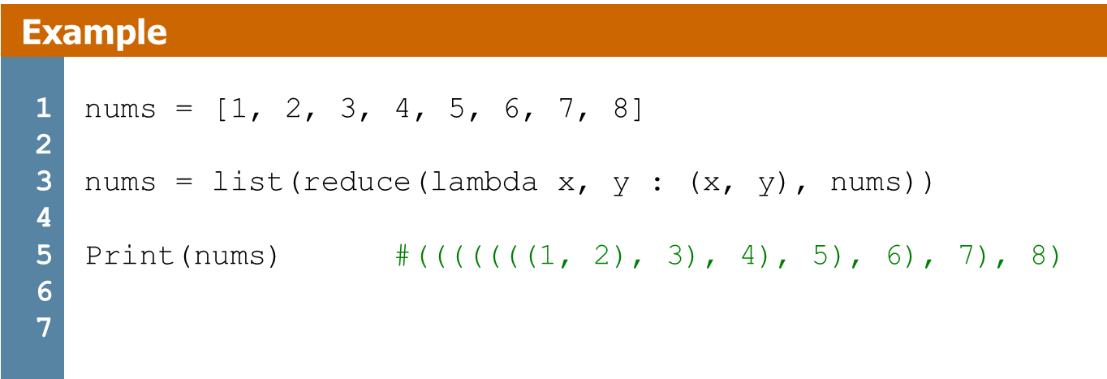
Reduce
reduce(function, iterable[,initializer])
Reduce will apply function to each element in iterable along with the sum so far and create a cumulative sum of the results
function must take two parameters
If initializer is provided, initializer will stand as the first argument in the sum
For example, to compute the sum of the numbers 1 through 10:
>>> def add(x,y): return x+y
>>> reduce(add, range(1, 11))
55

Slide 9
Reduce
If there's only one item in the sequence, its value is returned; if the sequence is empty, an exception is raised.
A third argument can be passed to indicate the starting value. In this case the starting value is returned for an empty sequence, and the function is first applied to the starting value and the first sequence item, then to the result and the next item, and so on.
For example,
>>> def sum(seq):
... def add(x,y): return x+y
... return reduce(add, seq, 0)
>>> sum(range(1, 11))
55
>>> sum([])
0

Slide 10
Exercise
1. Write a program that maps a list of words into a list of integers representing the lengths of the correponding words using the higher order function map()
2. Write a function find_longest_word() that takes a list of words and returns the length of the longest one. Use only higher order functions.
3. Using the higher order function filter(), define a function filter_long_words() that takes a list of words and an integer n and returns the list of words that are longer than n.

